Slide 1
Photon-Enhanced Thermionic Emission Using Light and Heat for Unprecedented Efficiency
Kristi Bohl
Energy Technologies for a Sustainable Future
September 14, 2010

Slide 2
The Opportunity:
Unprecedented Government Support for Solar Energy Technology
Clearly green energy appears to be a priority of the current Administration. But what does this mean? How can solar technologies benefit?

Slide 3
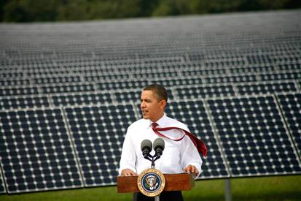
The Opportunity:
Unprecedented Government Support for Solar Energy Technology
The recession has served as a catalyst for green technologies:
demand for job creation
frustration with foreign
dependency
government desire to pump
money into the economy
“We’re going to keep competing aggressively to make sure the jobs and industries of the future are taking root right here in America.”
- President Obama, May 27, 2009

Slide 4
The Opportunity:
Benefits of the Recovery Act
“To provide investments needed to increase economic efficiency by spurring technological advances in science and health”

Slide 5
The Opportunity:
Benefits of the Recovery Act
Bang for the buck:
green technology:
1/6 of total spending
“Energy Efficiency and
Renewable Energy:”
$16.8 billion
competitive grants:
$400 million

Slide 6
The Opportunity:
Benefits of the Recovery Act
Bang for the buck:
green technology:
1/6 of total spending
“Energy Efficiency and
Renewable Energy:”
$16.8 billion
competitive grants:
$400 million
“We’ll invest in the development and deployment of solar technology wherever it can thrive and we’ll find the best ways to integrate solar power into our electric grid.”
- President Obama

Slide 7
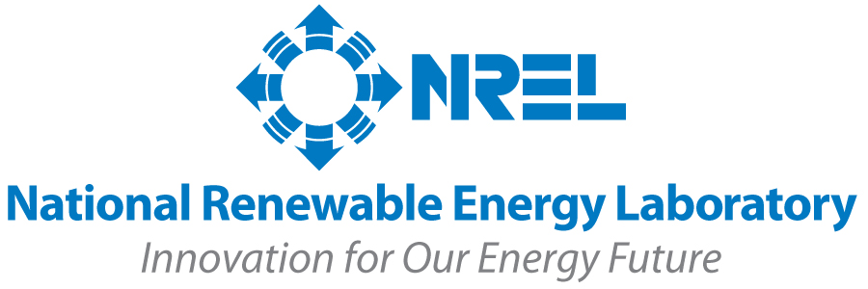
The Opportunity:
New Support and New Organizations
NREL: up to $12 million to “support the development of early stage solar energy technologies and help them advance to full commercial scale”
DOE: $12 million to “transition prototype… PV technologies into pilot and full-scale manufacturing.
Advanced Research Projects Agency – Energy (ARPA-E): incubator for sustainable technologies

Slide 8
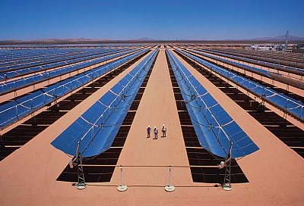
The Technology:
Limitations of Existing Technologies
“Quantum” techniques use only solar light
“Thermal” techniques use only solar heat

Slide 9
The Technology:
Limitations of Existing Technologies
“Quantum” techniques use only solar light
“Thermal” techniques use only solar heat
Why not use both??

Slide 10
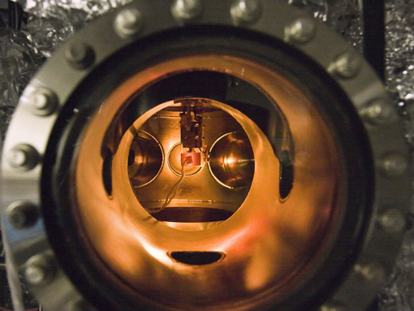
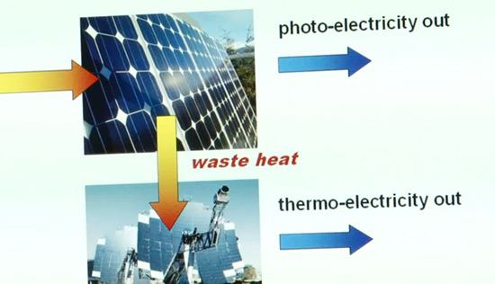
The Technology:
Pushing the Envelope on Efficiency
Go Cardinal!
Stanford researchers led
by Professor Nick
Melosh (MatSci)
technique allows for
simultaneous conversion
of solar light and heat
into electricity
theoretically, the device
could achieve 60%
efficiency
the current PETE device

Slide 11
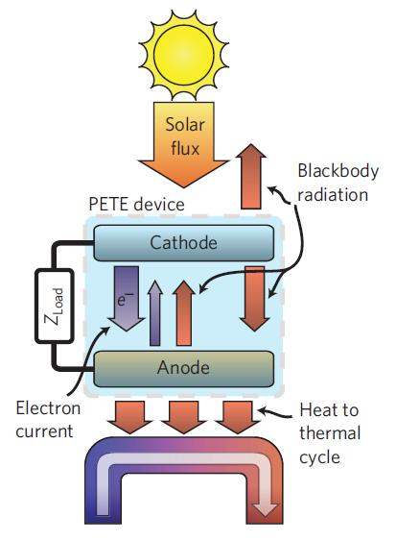
The Technology:
How it Works
“Photon-Enhanced:”
the quantum step
Photons strike the cathode, exciting electrons to produce current.
“Thermionic Emission:”
the thermal step
Concentrated solar heat produces electricity directly, including waste heat left over from quantum processes.

Slide 12
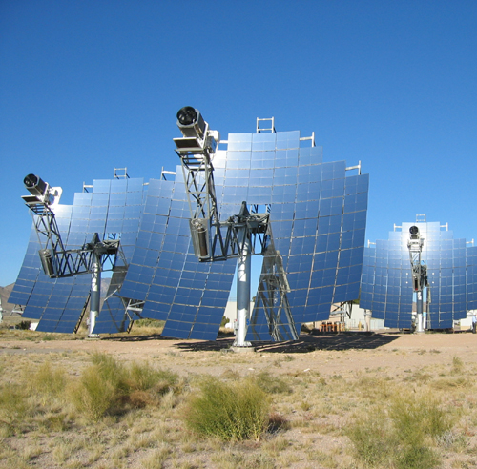
The Advantages:
Why PETE’s Got It Goin’ On
PETE’s optimal 60%
efficiency would
double that of existing
systems
Unlike PV cells, PETE
improves with higher
temperatures
Limited material
constraints
Cheap, plentiful,
accessible materials
Easily integrated into
existing technologies

Slide 13
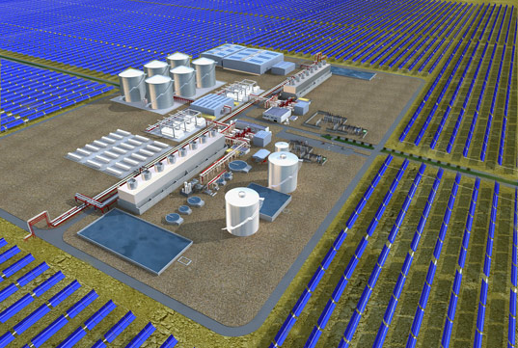
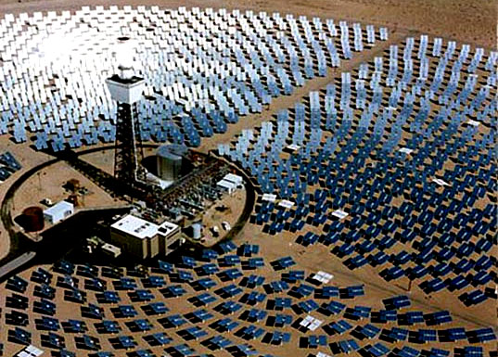
The Plan:
How to Scale up for Mass Production
Milestones:
material selection
confirmation of compatibility
efficiencies maintained
outside lab environments
The goal:
commercially viable: as cheap
as, or cheaper than, fossil fuels
market: large-scale utilities
and peripheral communities
integration: into existing
systems, replacing less
efficient solar thermal engines

Slide 14
Thank you for listening!

