Slide 1
A Behind-the-Scenes Look at Sports Journalism
Joseph Beyda

Slide 2
Outline
About me
Connecting players and fans
A day in the life of a sports journalist
Sports reporting crash course
Reporting exercise
Opportunities for high-school and college students

Slide 3
About Me
Grew up a die-hard Bay Area sports fan
Wrote for Monta Vista HS paper, El Estoque, as a junior and senior; also served as Managing Editor
Summer 2010: internships at Stanford Athletic Department’s Media Relations Office (SIDs) and The Stanford Daily
  Continuation: paid job at men’s basketball games and full-time role as staff writer/desk editor, respectively
100,000 published words, work featured online by New York Times and linked by ESPN.com

Slide 4
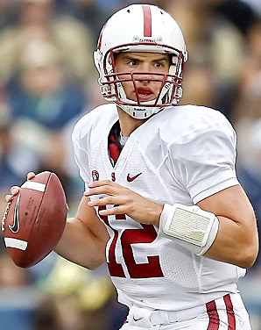
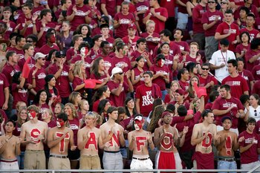
Connecting players and fans
?

Slide 5
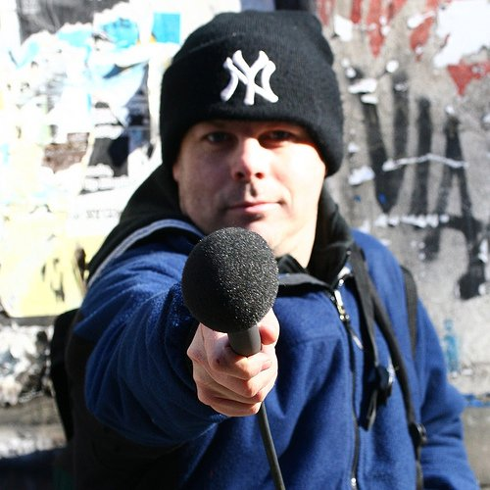
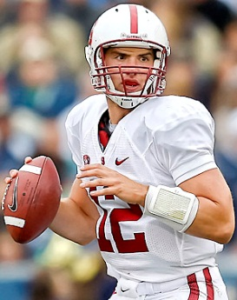
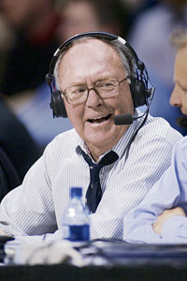
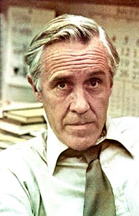
What goes in the middle?
SIDs
Journalists
Production

Slide 6
SIDs
Maintain the team website (gostanford.com)
Issue media passes
Coordinate interview/photo requests
Produce media guides
Write releases
Research
Work with marketing and ticket sales
“Bosses” of the press box
  Stats, live trackers, press conferences

Slide 7
Journalists
Print: newspapers, magazines, wire services (AP)
  Beat writers vs. columnists
Broadcast: radio, local TV stations, regional sports networks (CSN), national sports networks (ESPN)
Online: all of the above plus bloggers, stand-alone sports sites (Yahoo! Sports), social networkers

Slide 8
Production
Infrastructure behind the publishing of content
ESPN has 5,700 employees, but this accounts for much more than anch0rs, broadcasters, and writers
  Pre-production: script-writing, research (ESPN Stats and Info), graphic design

Slide 9
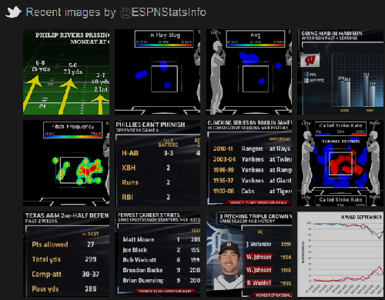

Slide 10
Production
Infrastructure behind the publishing of content
ESPN has 5,700 employees, but this accounts for much more than anch0rs, broadcasters, and writers
  Pre-production: script-writing, research (ESPN Stats and Info), graphic design
  On-set production: producers, camera crews, makeup artists, etc.
  Post-production: video and audio editing

Slide 11
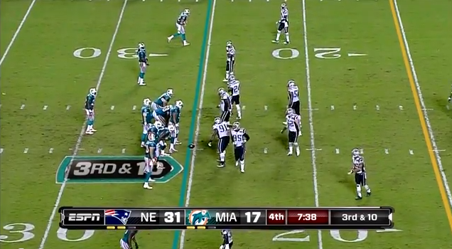

Slide 12
Production
Infrastructure behind the publishing of content
ESPN has 5,700 employees, but this accounts for much more than anch0rs, broadcasters, and writers
  Pre-production: script-writing, research (ESPN Stats and Info), graphic design
  On-set production: producers, camera crews, etc.
  Post-production: video and audio editing
  Online content: editors, webmasters

Slide 13
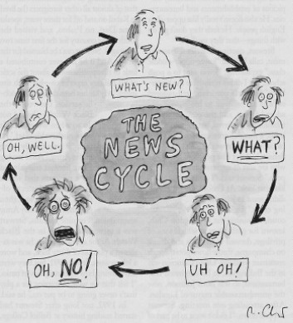
The News Cycle
-The New Yorker

Slide 14
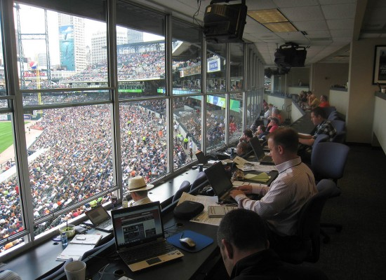
A Day in the Life of a Sports Journalist

Slide 15
Types of sports stories
Previews: leading up to a game
Recaps: after a game
Features: a certain player, coach, position group, or even the team as a whole (with a very specific angle)
Columns: a “sports editorial”; highly-personalized voice, humor and particular attention to style
Blog posts: shorter than a column, more regular, and more breaking

Slide 16
Before the Game: Do your homework!
How has each team been doing recently? Why? Against whom?
Have the teams played before?
What are the larger implications of the game? Making the postseason? Winning the conference? Breaking an individual or team record?
Which players should I be watching for?
  Who has been playing particularly well?
  Who has been struggling?

Slide 17
During the Game: How to Take Notes
Play-by-play: don’t get down everything unless you absolutely have enough time
  Basketball vs. baseball, for example
  Emphasize key moments
Note how your prior research is coming into play
Know which stats you have access to, where/who to get them, and when you will have them
  Keep simple stats if needed
Draft potential interview questions
Start writing pieces of your chronology

Slide 18
After the Game: How to Interview
Who should I interview?
  Head coach, when possible
  Players who had the biggest impact (not always the stars!)
What should I ask?
  Don’t fish for specific quotes; instead, work to refine your potential angles
  Zoom in, zoom out
  Take your interviewee’s perspective into account
  Come up with a broad range of questions, but pay attention so you can ask follow-ups
  Impress your interviewee with what you know

Slide 19
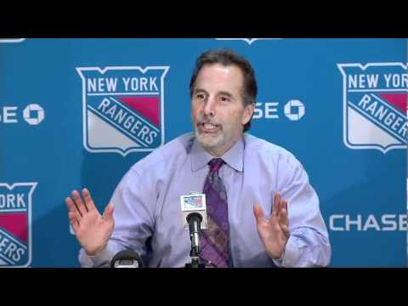
How to Improve Three Simple Questions
Wrong: “Who was your
star player today?”
  Coach’s reaction: “Did you
  even watch the game?”
Alternatives:
  “How do you think ___ played?”
  “How important is ___ to this team when he plays a game like that?”
  “What does ___ have to do improve as a player?”

Slide 20
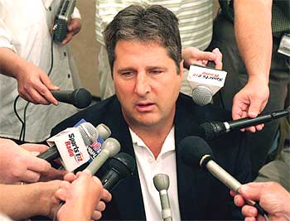
How to Improve Three Simple Questions
Wrong: “Why did your team
win/lose?”
  Coach’s reaction: “Because we
  didn’t score as much as the other
  team, smart one.”
Alternatives:
  “How important was ___ to your team’s win/loss?”
  “Is scoring your main concern, or is defense more important at this point?”

Slide 21
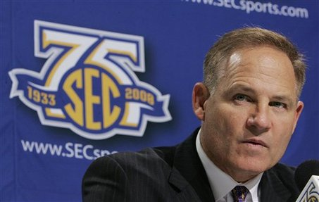
How to Improve Three Simple Questions
Wrong: “Do you think your
team will win ___?”
  Coach’s reaction: “What am I,
  a fortune-teller?”
  Player’s reaction: “Definitely.”
Alternatives:
  “What does your team have to do to win ___?”
  “What’s going to be your biggest challenge playing against ___?”

Slide 22
Sports Reporting Crash Course

Slide 23
Five Things You Need to Know
Know your sport
  What are the rules? What is the terminology? How popular is this sport to my audience?
Know your stats
  How do I use them? Where do I get them? Which ones are important? Which are commonly used?
Know your quotes
  Do I need to quote this? Who said it? Where should I put it in my story? What does the reader get out of this quote?
Know your specs
  How long is my story? When is it due?
Know how to use and, but, and however

Slide 24
Structure of a Recap
Read the following articles about the same game and try to separate each into four major sections.
http://www.nytimes.com/2011/10/30/sports/ncaafootball/stanford-defeats-usc-in-overtime.html?_r=2&ref=sports
http://www.sfgate.com/cgi-bin/article.cgi?f=/c/a/2011/10/29/SP781LO4QL.DTL

Slide 25
Section 1: The Lead
LOS ANGELES — Stanford’s perfect season was on the brink of ruin against U.S.C. on Saturday night because of a rare mistake by its impeccable quarterback Andrew Luck. With a little over three minutes to play in the fourth quarter, Luck threw a pass that cornerback Nickell Robey intercepted and returned 32 yards to put the Trojans ahead, 34-27.
The public-address announcer’s voice cut through the Coliseum crowd’s pandemonium, reminding the fans to stay off the field at game’s end. The message was received loud and clear by the Stanford players, who weren’t ready to concede defeat. Not with Luck on their side.
In Luck the Cardinal trust, and after he led them to a 56-48 victory in triple overtime, Stanford free safety Michael Thomas tipped his helmet to the public-address announcer for the premature declaration that fueled the Cardinal’s comeback.
The New York Times, Karen Crouse, “Stanford and Luck Pull Out a Victory”

Slide 26
Section 2: Analysis
“Oh, yeah,” Thomas said with a grin as Luck sat nearby nodding with a goofy smile illuminating his face. “We heard it.”
Luck, the fourth-year junior widely viewed as the second coming of John Elway, rebounded from the interception, his fourth of the season, with a 10-play drive that covered 76 yards, consumed a little over two minutes and was capped by a 2-yard run by Stepfan Taylor.
In overtime, he was cooler than the night air, scrambling for 13 yards on two carries, throwing an 11-yard touchdown pass to Levine Toilolo and connecting with Coby Fleener on a 2-point conversion following a 5-yard run by Taylor for the Cardinal’s final points.

Slide 27
Section 2: Analysis
Running back Curtis McNeal fumbled on the Trojans’ ensuing drive and the fourth-ranked Cardinal recovered the ball in the end zone to avoid falling from the ranks of the unbeaten, as Kansas State and Clemson had earlier in the day. It was Stanford’s nation-leading 16th consecutive victory. The last time the Cardinal (8-0) were undefeated this late in the season was in 1951 when their quarterback was Gary Kerkorian and they were one of eight teams in the conference. U.S.C. is 6-2, 3-2 in Pacific 12 play.
“One thing you can’t forget about Andrew is that he’s the most competitive guy on the team,” Stanford Coach David Shaw said. “So when a bad play happens, he goes completely down in the dumps. He’s so mad and furious and then it’s like flushing a toilet. He flushed it and it’s like it never happened. It’s gone. And he came back and the look in his eye, he said, ‘We’re going to get this done.’”

Slide 28
Section 2: Analysis
Luck passed for 330 yards and 3 scores. He was at his best when the chips were down, going 3 for 3 through the air in overtime and completing 16 of 22 passes in the third and fourth quarters when Stanford was chasing an inspired U.S.C. team.
“The stats aren’t going to show the plays he made,” U.S.C. Coach Lane Kiffin said, “but he’s a really special pocket passer and makes plays with his feet. It’s why he’ll be the first pick in the draft.”

Slide 29
Section 3: Chronology
Kiffin was critical of the officiating, expressing dismay that the Trojans were not afforded a timeout in the final second of the fourth quarter, after Robert Woods caught a 7-yard pass from Matt Barkley at the Stanford 33 to set up the potential game-winning field goal. After reviewing the play, the officials determined that the clock ran out.
“I told them we were going to call a timeout with one second left,” Kiffin said, “and was told by the side official that we’d have a chance to kick the 50-yard field goal to win it.”
Barkley passed for 284 yards and 3 touchdowns. He passed for 127 yards in the first half to Luck’s 99, but he also threw an interception that led to a Cardinal field goal as Stanford took a 10-6 lead into intermission.

Slide 30
Section 3: Chronology
Luck completed his first five passes – including a 10-yard score to Tyler Gaffney — as the Cardinal marched 83 yards on their opening drive to take a 7-0 lead. He cooled off after that, misfiring on 4 of his last 9 passes in the first half as the Trojans’ defensive line ran stunts that stumped Luck, who handles the Cardinal’s play calling.
The Trojans ran the ball seven times for 16 yards in the first half. McNeal, who finished with 154 yards on 20 carries, got U.S.C.’s running game out of first gear and into fifth in the third quarter with consecutive scoring runs of 61 and 25 yards to help the Trojans to a 20-10 lead.
It was the first time the Cardinal had trailed all season, but Luck was unfazed. He showed the crowd of 93,607 why fans of downtrodden N.F.L. franchises like the Miami Dolphins are rooting for their teams to lose so they can “earn” the No. 1 pick to draft him. In one stretch in the second half, he completed 10 consecutive passes. By the end of the third quarter, Luck had thrown for one touchdown and run for another to put the Cardinal back on top, 24-20.

Slide 31
Section 4: Ending
The Trojans regained the lead in the second minute of the fourth on a 28-yard pass from Barkley to Marquis Lee. Stanford tied the game at 27-27 on a 29-yard field goal by Eric Whitaker, and then appeared to lose it on Luck’s interception.
“I was very disappointed in myself,” Luck said. “There were a couple seconds there where I wanted to dig a hole and bury myself. But the guys believed in me. I was happy there was still some time on the play clock to go down there again. I was just relieved there was more clock left.”
Luck, who is 28-5 as a starter, was asked where the victory ranked on his career highlight list. “I might need a couple of minutes to digest that,” he said, adding, “It’s right up there.”

Slide 32
Section 1: The Lead
Los Angeles -- For the second year in a row, the matchup had a pulse-racing finish.
Last year, Stanford won on a field goal. That was merely a thriller.
This was a game for the ages.
Before a sellout crowd of 93,607 at the Coliseum, Stanford outlasted USC in the third overtime 56-48 when the Trojans' Curtis McNeal fumbled and linebacker AJ Tarpley recovered in the end zone.
The play gave the No. 4 Cardinal (8-0, 6-0 Pac-12) their third straight victory in the series with the Trojans (6-2, 3-2) and extended the nation's longest winning streak to 16 games.
San Francisco Chronicle, Tom FitzGerald, “Stanford stays unbeaten, beats USC 56-48 in 3 OTs”

Slide 33
Section 2: Analysis
"Wow. Wow. I tell you what, our guys fight," head coach David Shaw said. "They just kept fighting.“
Against a fired-up USC team, Luck completed 29 of 40 passes for 330 yards and three touchdowns, including one in the second overtime to tight end Levine Toilolo, who somehow got a foot down inbounds in the end zone.
Luck also was sacked twice, matching the total Stanford had given up this season, and threw an interception that Trojans cornerback Nickell Robey returned 33 yards for a touchdown with 3:08 left in regulation.
"I was very disappointed in myself," Luck said. "There were a couple seconds there when I wanted to dig a hole and bury myself. But the guys believed in me. I was happy there was still some time on the play clock to go down there again. I was just relieved there was more clock left."

Slide 34
Section 2: Analysis
Luck drove the Cardinal 76 yards, with Stepfan Taylor scoring on a 2-yard run to tie the score at 34-34 with 38 seconds left.
"He was so upset, for about 45 seconds, and then he flushed it," Shaw said of Luck. "And then he moved on and made the plays to help us win the game. ... We talk about fighting adversity. I didn't know it would be this much adversity. But the kids fought through it, and I love them to death for it."

Slide 35
Section 3: Chronology
In the first overtime Jeremy Stewart scored on a 1-yard plunge, but Matt Barkley (28-for-45, 3 TDs) hit Robert Woods with a 15-yard touchdown to make it 41-41.
USC tight end Randall Telfer scored with a strong second effort on a 12-yard pass play in the second OT. Stanford countered with Luck's 11-yard TD pass to Toilolo.
Taylor's 5-yard run put Stanford up 54-48, and, with two-point-conversion tries mandatory after the second OT, Luck hit a wide-open Coby Fleener to put Stanford up 56-48.
Then USC blinked. The Trojans were at the 4-yard line, but McNeal was hit hard and the ball rolled into the end zone, where Tarpley pounced on it.
"In a place like this, we knew it would be a tough game," Tarpley said. "I don't know if you can credit the defense too much. We just gave up (nearly) 50 points."

Slide 36
Section 3: Chronology
Luck's 2-yard touchdown on a quarterback draw gave the Cardinal a 24-20 lead late in the third quarter. It was set up by a razzle-dazzle play. Tyler Gaffney took the snap in the wildcat formation and handed off to Anthony Wilkerson, who pitched to Luck, who had lined up as a wide receiver. Luck found freshman Ty Montgomery for a 62-yard reception.
USC retrieved the lead at 27-24 early in the fourth quarter on Barkley's 28-yard touchdown pass to freshman Marqise Lee. Eric Whitaker, playing in place of an injured Jordan Williamson, kicked a 29-yard field goal to tie it 27-27 with 5:10 left.
The first half ended with Stanford ahead 10-6; the pointfest materialized much later. Stanford was without a big part of its offense when tight end Zach Ertz sustained a knee injury on the opening kickoff.
Williamson was gone even earlier, sustaining an injury while warming up. Whitaker, whose brother Nate decided last year's win over USC with a field goal, booted two field goals and hit all of his extra-point tries.

Slide 37
Section 3: Chronology
Gaffney gave Stanford a 7-0 lead on its opening possession by grabbing a pass from Luck, shaking off a tackle at the 5-yard line and diving at the pylon for a 10-yard touchdown.
USC took a 13-10 lead - the first time Stanford has trailed this season - on a 61-yard run by McNeal early in the second half. McNeal added a 25-yard TD run for a 20-10 lead.

Slide 38
Section 4: Ending
Why do you think this story ends so abruptly?
Can you think of a better way to bring it full-circle?

Slide 39
Reporting Exercise
My version of the story:
http://www.stanforddaily.com/2012/04/03/baseball-piscottys-pitching-crucial-in-11-inning-comeback-victory/

Slide 40
Opportunities for High-School and College Students

Slide 41
Opportunities for High-School Students
Join your school paper!
  Explore all areas of journalism
  Take on an editor role to get a better behind-the-scenes feel
Look out for day-long student media programs
Attend conventions
Look into summer internships at both college and professional newspapers
Make lots of mistakes – don’t be afraid to try something that scares you

Slide 42
Opportunities for College Students
Join your school paper!
Inquire at the SID office
Look into other forms of media: radio, broadcast, etc.
Build connections on press row
Build up a portfolio
Look into summer positions at professional newspapers and other media outlets

